Slide 1
Network Alignment: Treating Networks as Wireless Interference Channel
Chun Meng
Univ. of California, Irvine

Slide 2
Outline
Motivation:
  Network ≈ Wireless Interference Channel
Approaches:
  NA in the middle, Precoding-Based NA
PBNA
  Feasibility of PBNA
Conclusion

Slide 3
State of the Art - I
Intra-Session NC
  Achievable rate = min-cut^{[1,2]}
      LP-formulation^{[3]}
  Code design: RNC^{[4]}, deterministic^{[5]}
[1] R. Ahlswede, et al, “Network information flow”
[2] R. Koetter and M. M′edard, “An algebraic approach to network coding”
[3] Z. Li, et al, “On Achieving Maximum Multicast Throughput in Undirected Networks”
[4] T. Ho, et al, “A random linear network coding approach to multicast”
[5] S. Jaggi, et al, “Polynomial Time Algorithms for Multicast Network Code Construction”

Slide 4
State of the Art - II
Inter-Session NC
  Only approximation of bounds ^{[1]}
      Exponential number of variables
  Code design: NP-hard^{[5]}
      LP, evolutionary approach
[1] N. Harvey, et al, “On the Capacity of Information Networks”
[2] A. R. Lehman and E. Lehman, “Complexity classification of network information flow problems”
[3] D. Traskov, et al, “Network coding for multiple unicasts: An approach based on linear optimization”
[4] M. Kim, et al, “An evolutionary approach to inter-session network coding”

Slide 5







Restrictive Framework
$$X_{1}$$
$$Z_{1}$$
$$X_{2}$$
$$Z2$$
$$X_{3}$$
$$Z_{3}$$
Interference must be canceled out
R. Koetter and M. M′edard, “An algebraic approach to network coding”

Slide 6
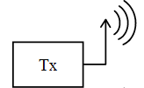













Network vs. Wireless Channel - I
Min-cut = 1
$$X_{1}$$
$$Z_{1}$$
$$x_{1}$$
$$y_{1}$$
$$X_{2}$$
$$Z2$$
$$x_{2}$$
$$y_{2}$$
$$X_{3}$$
$$Z_{3}$$
$$x_{3}$$
$$y_{3}$$
Network with multiple unicasts
SISO
Transfer function: introduced by network
Channel gain: introduced by nature

Slide 7














Networks vs. Wireless Channel - II
Min-cut > 1
$$X_{1}$$
$$Z_{1}$$
$$x_{1}$$
$$y_{1}$$
$$Z2$$
$$x_{2}$$
$$y_{2}$$
$$X_{2}$$
$$X_{3}$$
$$Z_{3}$$
$$x_{3}$$
$$y_{3}$$
Network with multiple unicasts
MIMO
Transfer matrix
Channel matrix

Slide 8
Interference Alignment
Common problem:
  Too MANY unknowns!
Solution:
  Align interferences to reduce the number of unknowns
Benefit:
  Everyone gets one half of the cake
V. Cadambe and S. Jafar, “Interference Alignment and Degrees of Freedom of the K-User Interference Channel”

Slide 9
Brief Intro of IA
Originally introduced by Cadambe & Jafar
Approaches:
  Asymptotic alignment,
  Ergodic alignment,
  Lattice alignment,
  Blind alignment
Applications
  K-user wireless interference channel,
  K-user MIMO interference channel,
  Cellular networks,
  Multi-hop interference networks,
  Exact repair in distributed storage
Syed A. Jafar, “Interference Alignment — A New Look at Signal Dimensions in a Communication Network”

Slide 10
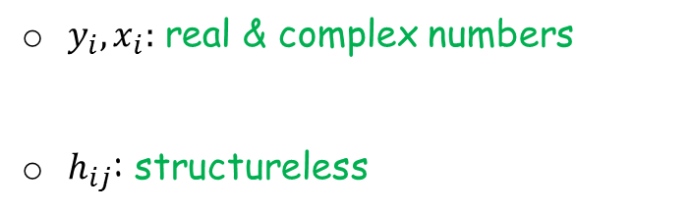
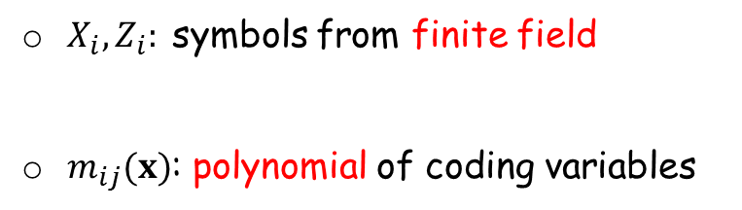
Network Is NOT Wireless Channel
$X_{i},Z_{i}:$symbols from finite field
$m_{ij}(x)$: polynomial of coding variables
$y_{i},x_{i}:$ real & complex numbers
$h_{ij}$: structureless

Slide 11
Outline
Motivation:
  Network ≈ Wireless Interference Channel
Approaches:
  NA in the middle, Precoding-Based NA
PBNA
  Feasibility of PBNA
Conclusion

Slide 12











NA in the Middle
t=1
t=2
$$X_{1}$$
$$Z_{1}^{1}$$
$$X_{1}$$
$$Z_{1}^{2}$$
$$X_{2}$$
$$Z_{2}^{1}$$
$$X_{2}$$
$$Z_{2}^{2}$$
$$X_{3}$$
$$Z_{3}^{1}$$
$$X_{3}$$
$$Z_{3}^{2}$$
NA in the middle:
≠
=
=
B. Nazer, et al, "Ergodic Interference Alignment"

Slide 13
NA in the Middle: Pros & Cons
Pros:
  Achieve ½ in exactly 2 time slots
Cons:
  Finding code is NOT easy

Slide 14
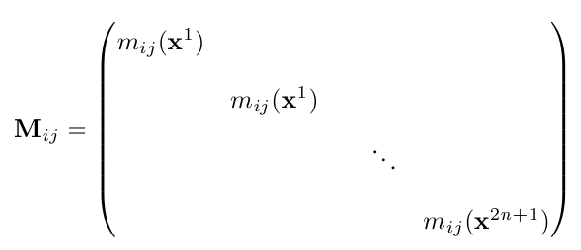
Precoding-Based NA - I
S₁
2n+1 uses of network
or 2n+1 symbol extension
D₁
x₁
n+1
y₁=V₁x₁
2n+1
S₂
D₂
x₂
n
y₂=V₂x₂
2n+1
S₃
D₃
x₃
n
y₃=V₃x₃
2n+1
V. R. Cadambe and S. A. Jafar, "Interference Alignment and Degrees of Freedom of the K-User Interference Channel“

Slide 15



Precoding-Based NA - II
M₁₁V₁x₁
M₁₂V₂x₂
M₁₃V₃x₃
M₂₂V₂x₂
Align interferences
M₂₃V₃x₃
M₂₁V₁x₁
M₃₃V₃x₃
M₃₂V₂x₂
M₃₁V₁x₁

Slide 16


Precoding-Based NA - III
Alignment conditions
Rank conditions

Slide 17

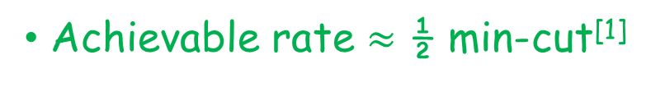
Precoding-Based NA - Advantages
Code design is simple
  Encoding & decoding are predetermined regardless of topology
Achievable rate $≈$ ½ min-cut^{[1]}

Slide 18







Get a Better Understanding
V₁ can NOT be chosen freely!

Slide 19










Reformulated Feasibility Cond.
Condensed alignment cond.
Reformulated rank cond.

Slide 20


Algebraic Formulation - I
$η(x)$ is not constant. V₁ can NOT be arbitrary matrix

Slide 21
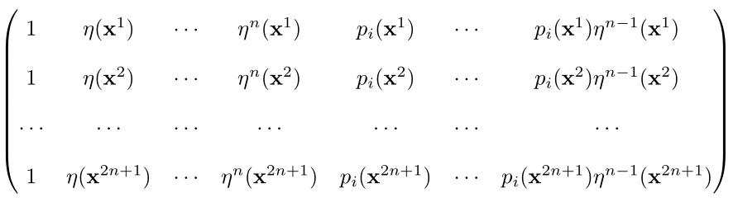
Algebraic Formulation - II

Slide 22

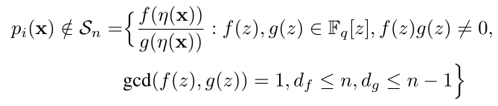
Algebraic Formulation - III
is full rank
Linearly independent

Slide 23
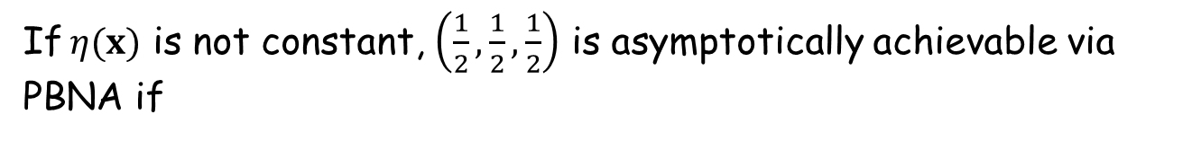
Algebraic Formulation - IV
$\left(\frac{n+1}{2n+1},\frac{n}{2n+1},\frac{n}{2n+1}\right)$ is achievable via PBNA if
If $η(x)$ is not constant, $\left(\frac{1}{2},\frac{1}{2},\frac{1}{2}\right)$ is asymptotically achievable via PBNA if

Slide 24



Algebraic Formulation - V
$η(x)$ is constant. Setting AB=C, V₁ can be arbitrary matrix

Slide 25

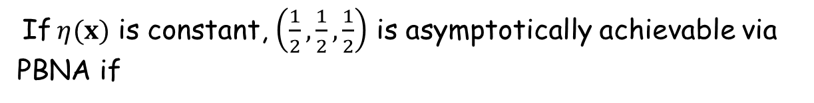
Algebraic Formulation - VI
If $η(x)$ is constant, $\left(\frac{1}{2},\frac{1}{2},\frac{1}{2}\right)$ is asymptotically achievable via PBNA if
p_{i}(x) is not constant

Slide 26
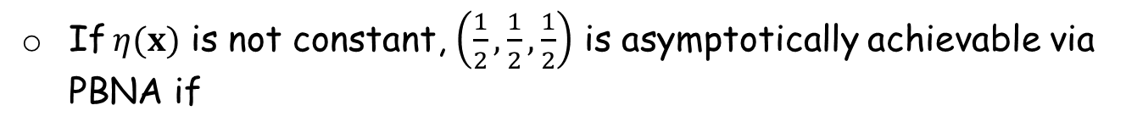
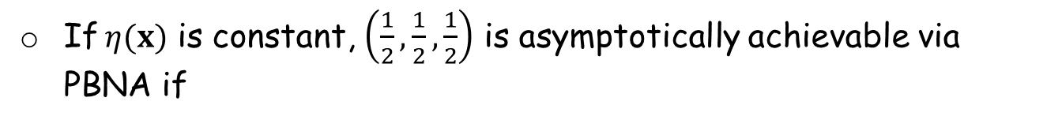
Summarization
If $η(x)$ is not constant, $\left(\frac{1}{2},\frac{1}{2},\frac{1}{2}\right)$ is asymptotically achievable via PBNA if
If $η(x)$ is constant, $\left(\frac{1}{2},\frac{1}{2},\frac{1}{2}\right)$ is asymptotically achievable via PBNA if
p_{i}(x) is not constant

Slide 27
Outline
Motivation:
  Network ≈ Wireless Interference Channel
Approaches:
  NA in the middle, Precoding-Based NA
PBNA
  Feasibility of PBNA
Conclusion

Slide 28








Unfriendly Networks - I
If $η(x)$ is constant, $\left(\frac{1}{2},\frac{1}{2},\frac{1}{2}\right)$ is asymptotically achievable via PBNA if
p_{i}(x) is not constant
$$X_{1}$$
$$Z_{1}$$
$$X_{2}$$
$$Z_{2}$$
$$e$$
$$X_{3}$$
$$Z_{3}$$

Slide 29




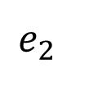

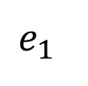


Unfriendly Networks - II
If $η(x)$ is not constant, $\left(\frac{1}{2},\frac{1}{2},\frac{1}{2}\right)$ is asymptotically achievable via PBNA if
$$X_{1}$$
$$Z_{1}$$
$$e_{1}$$
$$X_{2}$$
$$Z_{3}$$
$$X_{3}$$
$$e_{2}$$
$$Z_{2}$$

Slide 30

Coupling Relations
$∃$ network for which the relation holds, it is realizable

Slide 31







Coupling Relations are Mostly Bad
Bad guys
Good guy
$$X_{1}$$
$$Z_{1}$$
$$X_{2}$$
$$e_{2}$$
$$Z_{2}$$
$$X_{3}$$
$$e_{1}$$
$$Z_{3}$$
Arbitrary precoding matrix V₁ is OK

Slide 32
Networks vs. Wireless Channel
Have structures
Structureless
Coupling relations
Can change independently
Feasibility conditions
are violated
IA is always feasible

Slide 33


NOT All Coupling Relations are Realizable
Max degree of x_{ee’} ≤ 2
Max degree of x_{ee’} ≥ 3
Q1: Which coupling relations $p_{i}\left(x\right)=\frac{f\left(η\left(x\right)\right)}{g\left(η\left(x\right)\right)}$are realizable?

Slide 34








Topology and Coupling Relations
$$X_{1}$$
$$Z_{1}$$
$$X_{1}$$
$$Z_{1}$$
$$X_{2}$$
$$Z_{2}$$
$$X_{2}$$
$$Z_{3}$$
$$X_{3}$$
$$Z_{3}$$
$$X_{3}$$
$$Z_{2}$$
Q2: What is the network topology for $p_{i}\left(x\right)=\frac{f\left(η\left(x\right)\right)}{g\left(η\left(x\right)\right)}$ ?

Slide 35
How About Other Precoding Matrices?
The ONLY one ?
Q3: If $V_{1}^{∗}$ can not be used, how about others?

Slide 36
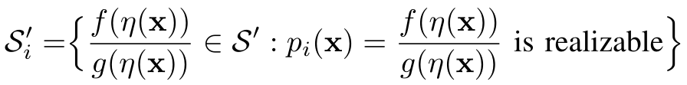



Answer to Q1
Q1: Which coupling relations $p_{i}\left(x\right)=\frac{f\left(η\left(x\right)\right)}{g\left(η\left(x\right)\right)}$are realizable?
Answer:

Slide 37
Answer to Q3
Q3: If $V_{1}^{∗}$ can not be used, how about others?
Answer:
NO !

Slide 38



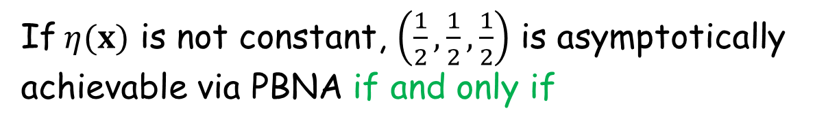
Combining the Answers to Q1 & Q3
If $η(x)$ is not constant, $\left(\frac{1}{2},\frac{1}{2},\frac{1}{2}\right)$ is asymptotically achievable via PBNA if and only if

Slide 39








Key Idea Behind Q-1
Graph-related properties
$$σ_{1}$$
$$τ_{1}$$
$$e_{1}$$
$$e_{3}$$
$$e_{2}$$
$$e_{4}$$
$$e_{6}$$
$$e_{5}$$

Slide 40

Graph-Related Properties - I
How to check p_{i}(x) is not constant?
1
2
1
3
1
2
1
2
1
3
1
3

Slide 41


Graph-Related Properties - II
Linearization Property
Assign values to x
Max degree = 1

Slide 42


Graph-Related Properties - III
Intuition behind Linearization Property
1
2
e
e’
1
3

Slide 43



Graph-Related Properties - IV
Square-Term Property
Implication:
Assign values to x

Slide 44
Graph-Related Properties - V
Intuition behind Square-Term Property
1
2
1
2
e
e
e’
e’
1
3
1
3

Slide 45



Finding Realizable Coupling Relations - I
Objective:
Step I
Max degree of f(z) and g(z) = 1
Assign values to x

Slide 46





Finding Realizable Coupling Relations - II
Step II
Define
No square term
in the numerator

Slide 47


Finding Realizable Coupling Relations - III
Step III
Unrealizable
[1] J. Han, et al, “Analysis of precoding-based intersession network coding and the corresponding 3-unicast interference alignment scheme”

Slide 48


How to Answer Q3 ?
Q3: If $V_{1}^{∗}$ can not be used, how about others?
How to construct V₁ ?

Slide 49
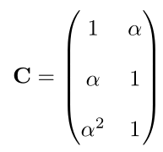
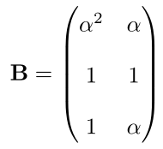

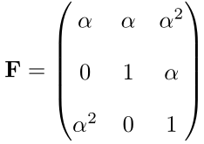

Example: Construct V₁

Slide 50

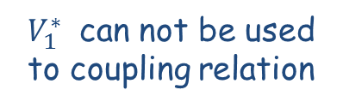
All Precoding Matrices Are Equivalent
$V_{1}^{∗}$ can not be used to coupling relation
Any V₁ cannot be used

Slide 51

Topology of Coupling Relations - I
Q2: What is the network topology for $p_{i}\left(x\right)=\frac{f\left(η\left(x\right)\right)}{g\left(η\left(x\right)\right)}$ ?
1
2
1
3

Slide 52
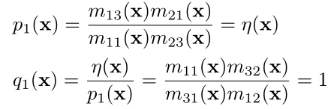
Topology of Coupling Relations - II
1
3
1
2

Slide 53


Topology of Coupling Relations - III
$$X_{1}$$
$$Z_{1}$$
$$X_{2}$$
$$Z_{3}$$
$$X_{3}$$
$$Z_{2}$$

Slide 54
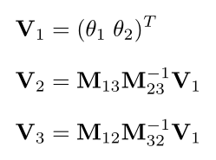
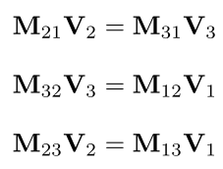

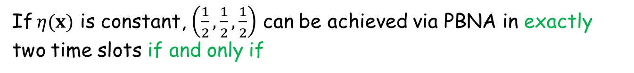
Trivial Case
$η(x)$ is constant and T is identity matrix
Perfectly aligned
If $η(x)$ is constant, $\left(\frac{1}{2},\frac{1}{2},\frac{1}{2}\right)$ can be achieved via PBNA in exactly two time slots if and only if
p_{i}(x) is not constant

Slide 55

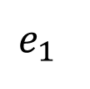






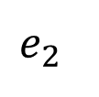
Trivial Case - Example
$$1$$
$$1$$
$$2$$
$$e_{2}$$
$$2$$
$$3$$
$$e_{1}$$
$$3$$

Slide 56
Outline
Motivation:
  Network ≈ Wireless Interference Channel
Approaches:
  NA in the middle, Precoding-Based NA
PBNA
  Feasibility of PBNA
Conclusion

Slide 57
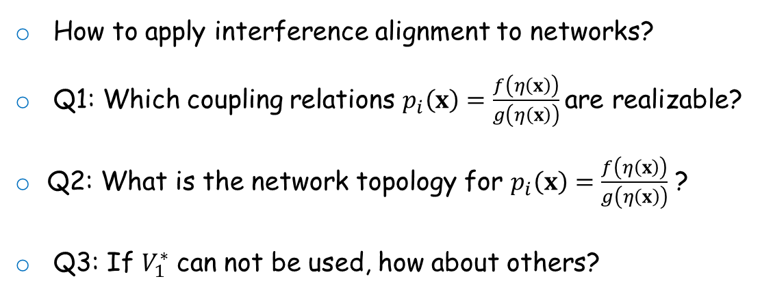
Conclusion
How to apply interference alignment to networks?
Q1: Which coupling relations $p_{i}\left(x\right)=\frac{f\left(η\left(x\right)\right)}{g\left(η\left(x\right)\right)}$are realizable?
Q2: What is the network topology for $p_{i}\left(x\right)=\frac{f\left(η\left(x\right)\right)}{g\left(η\left(x\right)\right)}$ ?
Q3: If $V_{1}^{∗}$ can not be used, how about others?

Slide 58
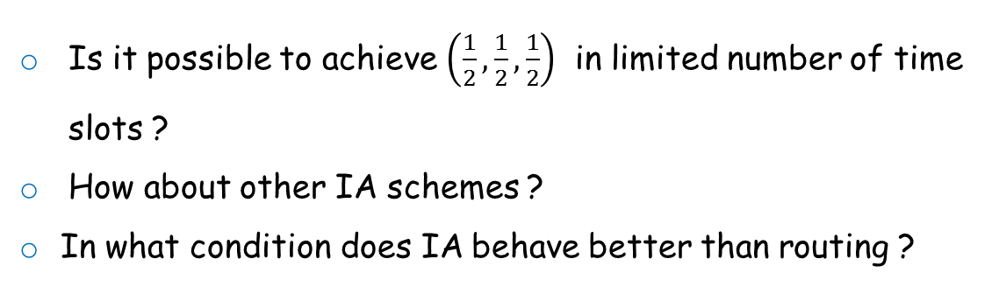
Open Questions
Is it possible to achieve $\left(\frac{1}{2},\frac{1}{2},\frac{1}{2}\right)$ in limited number of time slots ?
How about other IA schemes ?
In what condition does IA behave better than routing ?

Slide 59
Thank you !
Questions ?
http://odysseas.calit2.uci.edu/doku.php/public:publication

